Slide 1
Shimmer3 IMU Research

Slide 2
Project Outline
Hardware Requirements
Shimmer3 IMU Device.
Windows 10 PC/Laptop
Mac OS Version 10.13 or Later
Investigate gathering real time data from Shimmer3 IMU device for use with 3D model rotation and data analysis from player movement in a training scenario.
This application will target Rugby specifically and aims to prevent injury by identifying danger areas while tackling.
Facilitate post analysis of the data with the player and assist players to perform, learn and practice safe tackling in a training environment.
Identify limitations with hardware or software applications.
Record findings and determine viability as a useable application.
Software Requirements
Unity 3D

Slide 3
Project Architecture
Developed in Unity and C#
Unity3D Platform.
Bluetooth Data Streaming.
Impact and Rotation tracking.
Simple Device finder.

Slide 4
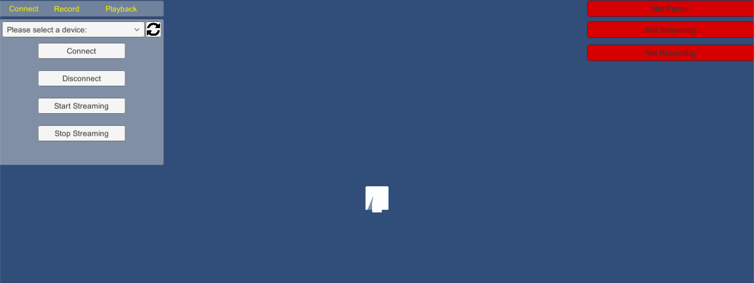
Connect Panel.
Select Shimmer device.
Connect/
Disconnect device.
Start/Stop Streaming data.

Slide 5
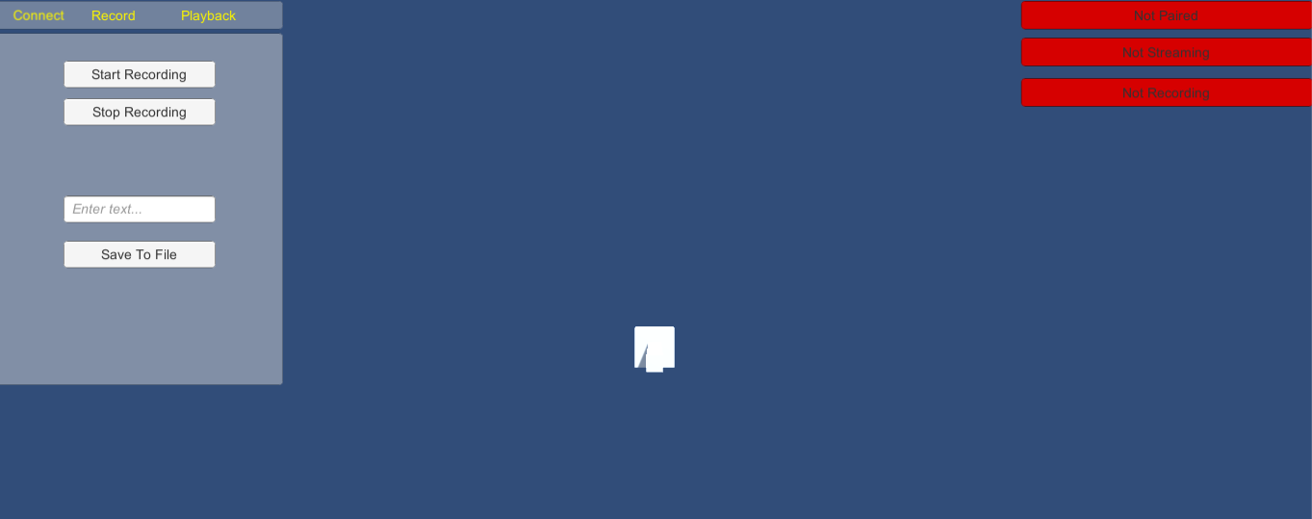
Recording Panel.
Start/Stop recording from shimmer.
Save the data to file.
Text box to enter filename.

Slide 6
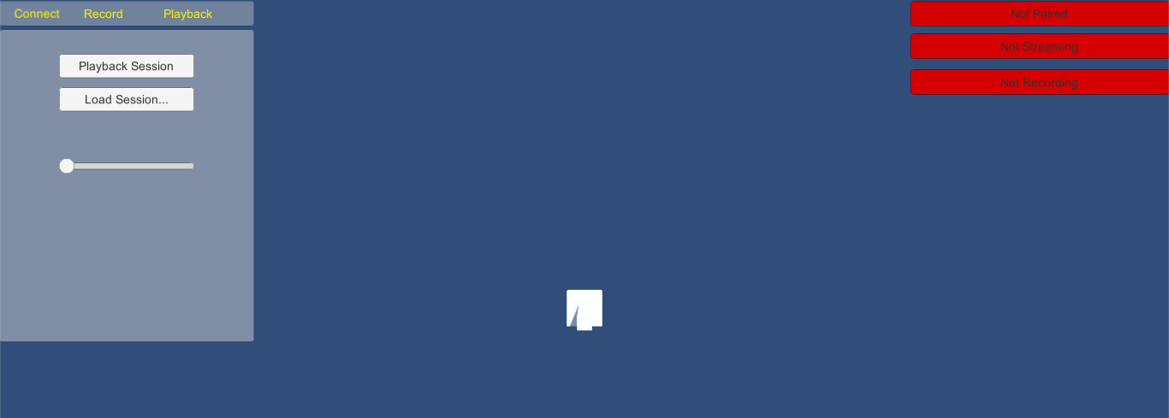
Playback Panel
Playback session after loading in from file.
Load a file for play back.
Slider to set Playback speed.

Slide 7
CONCEPT
🏃
🏃

Slide 8
Other Research
Thalmic Myo Armband
Investigated Myo rotation and positional tracking over bluetooth.
Finetuned rotation in shimmer project.
WPF Application
Built object in C# application, rotating with shimmer device.

Slide 9
Other Research
Uduino
Rotating a 3D model in Unity using a 6 degrees of freedom IMU sensor.
Blender
Modelled a humanoid figure in Blender to use as a prop in the unity application.
Device Config
SDK included configuration software to set up the shimmer units.
Export/Import configs

Slide 10
LET’S REVIEW SOME OUTCOMES
Rotation and Impact
Rotating a model in 3D space with data from the shimmer device.
Detecting Impact with slider to increase/ decrease the impact threshold.
Persistence
Data from training sessions can be saved and loaded for later analysis
Connectivity
Simple connection menu and device finder menu to locate paired devices.
Green/red UI feedback.
Streaming
Start/Stop streaming and simple green/red UI feedback
Recording
Start/Stop recording training sessions.
Save sessions to csv file.
Playback
Load saved files and playback.
Set playback speed with slider.

Slide 11

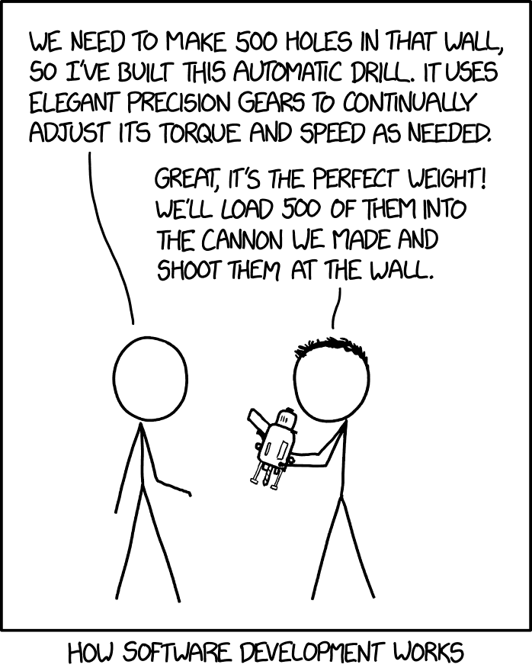
THANKS!
Any questions?
Contact:
Justin – 10023036@gmit.ie
David – G00351365@gmit.ie

